Slide 1
Azure Machine Learning Studio tutorial
Thomas Delissen – 10.11.2017

Slide 2
Content
Basic machine learning approach
Sample model approach
Understanding the data
Overview of steps

Slide 3
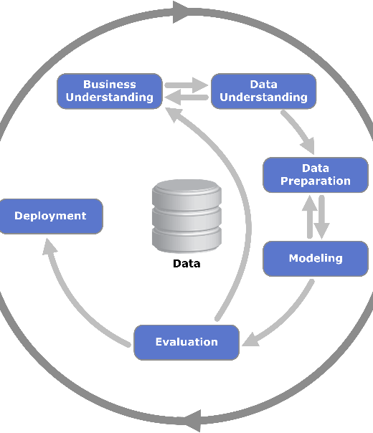
Basic machine learning approach (aka Data Science)
We will do supervised learning, meaning a standard Classification or Regression problem.
We will make a simple hypothesis and create a simple prediction model; this is just to show you how it works
We will use a sample data set, in this case the Garmin data from Pascal
We will do as much as possible in Azures Machine Learning Studio

Slide 4
Sample model approach
Load raw data CSV
Clean data
This is the training cycle.
You need to determine the parameter you want to predict first.
After training, the model can be deployed as a webservice, where you put in data, and get out a prediction.
split
Training set 80%
Test set 20%
Model definition (For example: Linear Regression)
Train model
Test model
Prediction / Accuracy output

Slide 5
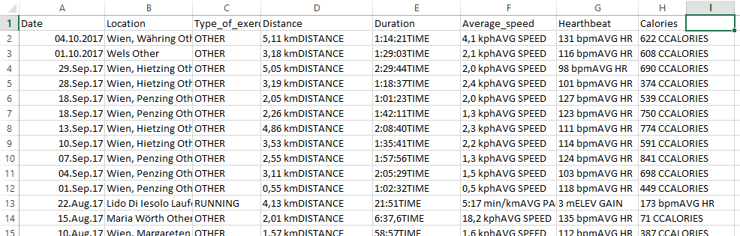
Understanding the data
Normally, you would do proper business analysis and data analysis to determine the business problems and come up with ways to solve that.
Here we will just look at the data and pick a parameter to predict. Parameters are:
Date, Location, Type_of_exercise, Distance, Duration, Average_speed, Heartbeat, Calories
Maybe we can try to predict Pascals heartbeat based on the Distance and Duration parameters.
Average_speed and Calories sound like derived parameters, so we will not use them.

Slide 6
Overview of steps
Open portal.azure.com and log in
Add a new resource: Machine learning studio workspace
Launch machine learning studio
4. Create a new project
5. Prepare data: Make sure number formats are correct and there are no missing values. With Strings we need to be careful as well.

Slide 7
Overview of steps
Upload CSV data into Dataset
Create Experiment
Add Dataset to experiment
At this point, you can do some exploratory visualizations
Clean dataset (optionally)
Split dataset
Initialize machine learning model
Train machine learning model
Test machine learning model
Evaluate machine learning model
Deploy as a predictive webservice

